Slide 1
Difference between Oracle PL/SQL and MySQL

Slide 2
MySQL PL/SQL control statements

Slide 3
PL/SQL Introduction
PL/SQL is a combination of SQL along with the procedural features of programming languages.
Basic Syntax of PL/SQL which is a block-structured language; this means that the PL/SQL programs are divided and written in logical blocks of code.
Each block consists of three sub-parts

Slide 4
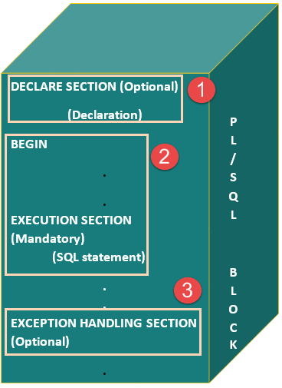
Pl/SQL Block structure

Slide 5
Pl/SQL Block structure Explanation
Sections | Description
Declarations | This section starts with the keyword DECLARE. It is an optional section and defines all variables, cursors, and other elements to be used in the program.
Executable Commands | This section is enclosed between the keywords BEGIN and END and it is a mandatory section. It consists of the executable PL/SQL statements of the program. It should have at least one executable line of code.
Exception Handling | This section starts with the keyword EXCEPTION. This optional section contains exception(s) that handle errors in the program.

Slide 6
The 'Hello World' Example
DECLARE
Message varchar(20):= 'Hello World!';
BEGIN
dbms_output.put_line(Message);
END; /

Slide 7
Types of PL/SQL block
PL/SQL blocks are of mainly two types.
Anonymous blocks
Named Blocks

Slide 8
Unnamed block Examples
Not possible in MySQL but possible with oracle SQL

Slide 9
Unnamed block in oracle
SQL> set serveroutput on; // to show output on screen
SQL> declare // For loop
2 A number:=1;
3 begin
4 for A in 1..10 loop
5 dbms_output.put_line(A);
6 end loop;
7 end;

Slide 10
Unnamed block in oracle
SQL> declare // if-else
2 a number(4);
3 begin
4 for a in 5..15 loop
5 if mod(a,5)=0 then
6 dbms_output.put_line(a);
7 else
8 dbms_output.put_line('value'||a);
9 end if;
10 end loop;
11 end;

Slide 11
Named block
Examples:
Procedures
Functions

Slide 12
Some basic difference in PL/SQL (Oracle & MySQL)
Oracle | MySQL
set serveroutput on; | Delimiter //
dbms_output.put_line | Not available in MySQL
Unnamed block | Not available in MySQL
Named block: Stored procedure and function | Named block: Stored procedure and function
Cursor: Implicit, Explicit | Cursor: only Explicit
Trigger: Row level and statement level | Trigger: Row level

Slide 13
Procedure syntax
CREATE [OR REPLACE] PROCEDURE procedure_name [ (parameter [,parameter]) ] as [declaration_section] BEGIN executable_section [EXCEPTION exception_section]
END
CREATE [OR REPLACE] PROCEDURE procedure_name [ (parameter [,parameter]) ] [declaration_section] BEGIN executable_section [EXCEPTION exception_section]
END

Slide 14
Procedure Example and running the procedure
SQL> Set Server output on;
SQL> create or replace procedure delcust(id number)as
begin
delete from cust where cid=id;
end;
/
SQL> exec delcust(1);
MySQL> delimiter //
MySQL>create procedure delcust(IN id int(3))
begin
delete from cust where cid=id;
end;
//
MySQL> delimiter ;
MySQL>call delcust(1) ;

Slide 15
Function Example
SQL> create or replace function Rname(rno1 number)return varchar is
sname stud.name%type;
Begin
select name into sname from Stud where rno=rno1;
return sname;
end;
SQL> select Rname(1)from dual;
mysql> create function Rname(rno1 int)returns varchar
begin
declare sname varcahr(20);
select name into sname from Stud where rno=rno1;
return sname;
end;
mysql> select Rname(1) ;

Slide 16
Cursor Example
SQL> declare
cursor c1 is select rno,name from stud;
rno1 stud.rno%type;
name1 stud.name%type;
begin
open c1;
loop
fetch c1 into rno1,name1;
exit when c1%notfound;
dbms_output.put_line(cust1.cid ||' '|| cust1.name);
end loop;
close c1;
end;
MySQL>CREATE PROCEDURE Stud1()
BEGIN DECLARE c1 CURSOR FOR select rno,name from stud;
DECLARE rno1 int(3); DECLARE name1 varchar(20);
DECLARE exit_loop BOOLEAN; DECLARE CONTINUE HANDLER FOR NOT FOUND SET exit_loop = TRUE;
OPEN c1; emp_loop: LOOP FETCH c1 INTO rno1,name1;
select rno1,name1; IF exit_loop THEN CLOSE c1; LEAVE emp_loop; END IF;
END LOOP emp_loop; END
MySQL>call Stud1();

Slide 17
Trigger Example
SQL> create trigger t1 after insert on emp
for each row
when(new.sal>10000)
begin
insert into emphigh values(:new.ename,:new.sal);
End;
/
MySQL> create trigger t1 after insert on emp
for each row
begin
IF NEW.sal >10000 THEN
insert into emphigh values(new.ename,new.sal);
End;
/

